Slide 1
Welcome to My Presentation

Slide 2
My Presentation Topic is Java Operator
Presented By:
Name : Tushar Sarkar
Student ID: 18CSE035
Second Year First Semester
Department of CSE,BSMRSTU,
Gopalganj-8100.

Slide 3
Content
What is Java Operator?
Arithmetic Operators
Arithmetic Operators Example
Assignment Operators
Assignment Operators Example
Relational Operators
Relational Operators Example
Logical Operators
Unary Operators
Increment and Decrement Operators
Increment and Decrement Operators Example
Bitwise Operators
Ternary Operator

Slide 4
What is Java Operator?
Operators are symbols that perform operations on variables and values.
For example, + is an operator used for addition, while * is also an operator used for multiplication.
Operators in Java can be classified into 6 types:
Arithmetic Operators
Assignment Operators
Relational Operators
Logical Operators
Unary Operators
Bitwise Operators

Slide 5
Arithmetic Operators
Arithmetic operators are used to perform arithmetic operations on variables and data.
For example,
a + b;
Here, the + operator is used to add two variables a and b.
Similarly, there are various other arithmetic operators in Java.
Operator | Operation
+ | Addition
- | Subtraction
* | Multiplication
/ | Division
% | Modulo Operation

Slide 6
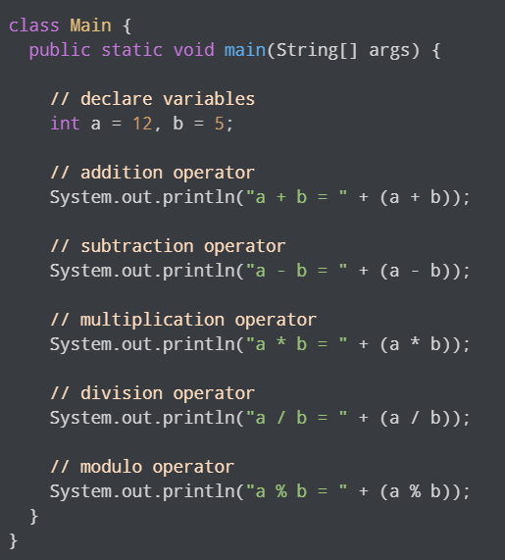
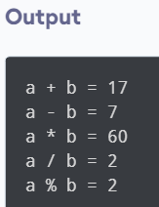
Arithmetic Operators Example
In the above we have use + - */ and % operators to compute addition, subtraction, multiplication, division and modulo operations.

Slide 7
Assignment Operators
Assignment operators are used in Java to assign values to variables.
For example, int age; age = 5;
Here, = is the assignment operator.
It assigns the value on its right to the variable on its left.
That is, 5 is assigned to the variable age.
Let's see some more assignment operators available in Java.
Operator | Example | Equivalent to
= | a = b; | a = b;
+= | a += b | a = a + b;
-= | a -= b; | a = a - b;
*= | a *= b; | a = a * b;
/= | a /= b; | a = a / b;
%= | a %= b; | a = a % b;

Slide 8
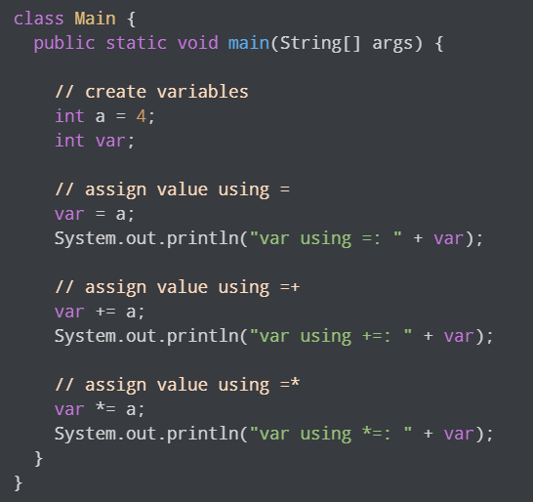
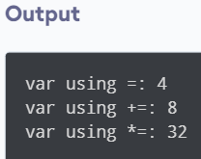
Assignment Operators Example

Slide 9
Relational Operators
Relational operators are used to check the relationship between two operands.
For example,
a < b;
Here, > operator is the relational operator.
It checks if a is less than b or not.
It returns either true or false
Operator | Description | Example
== | Is Equal To | 4 == 5 return false
!= | Not Equal To | 4 != 5 return true
> | Greater Than | 4 > 5 return false
< | Less Than | 4 < 5 return true
>= | Greater Than or Equal To | 4 >= 5 return false
<= | Less Than or Equal To | 4 <= 5 return false

Slide 10
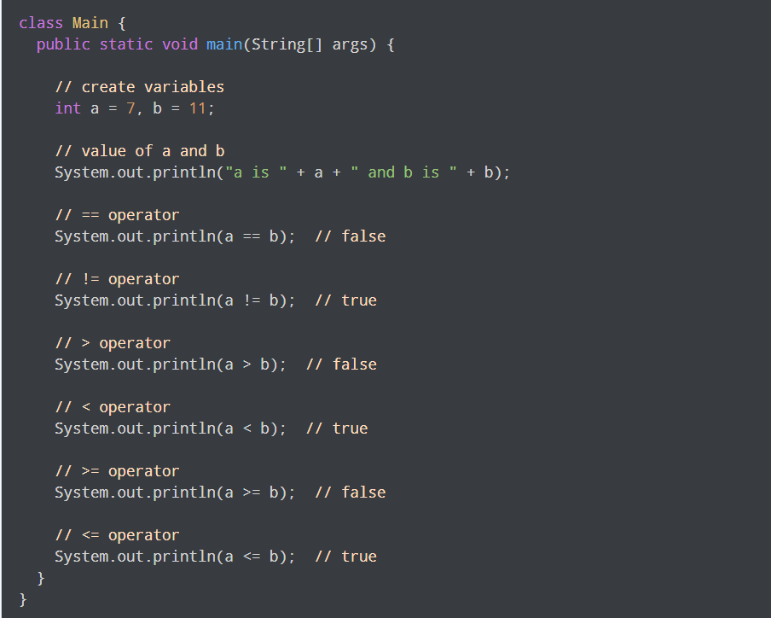
Relational Operators Example
Note: Relational operators are used in decision making and loops

Slide 11
Logical Operators
Logical operators are used to check whether an expression is true or false.
They are used in decision making.
Operator | Example | Meaning
&& (Logical AND) | Expression1 && Expression2 | True only if both expression1 and expression2 are true
|| (Logical OR) | Expression1 || Expression2 | True if either expression1 or expression2 is true
! (Logical NOT) | !Expression | True if expression is false and vice versa

Slide 12
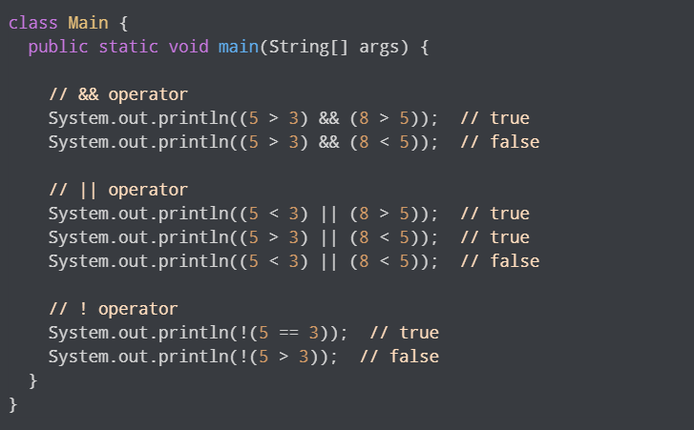
Logical Operators Example
Working of Program :
(5>3) && (8>5) returns true because (5>3) and (8>5) are true.
(5>3) && (8<5) returns false because (8<5) are false.
(5<3 || 8>5) returns true because (8>5) are true.
(5<3 || 8<5) returns false because (5<3) and (8<5) are false.
!(5==3) returns false because 5 is not equal to 3.

Slide 13
Unary Operators
Unary operators are used with only one operand.
For example, ++ is a unary operator that increases the value of a variable by 1.
That is, ++5 will return 6.
Different types of unary operators are:
Operator | Meaning
+ | Unary plus : not necessary to use since numbers are positive without using it
- | Unary minus : inverts the sign of an expression
++ | Increment operator : increments value by 1
-- | Decrement operator : decrements value by 1
! | Logical complement operator : inverts the value of a boolean

Slide 14
Increment and Decrement Operators
Java also provides increment and decrement operators : ++ and -- respectively.
++ increase the value of the operand by 1, while -- decrease it by 1.
For Example,
int num = 5;
// increase num by 1
++num;
Here, the value of num gets increased to 6 from its initial value of 5.

Slide 15
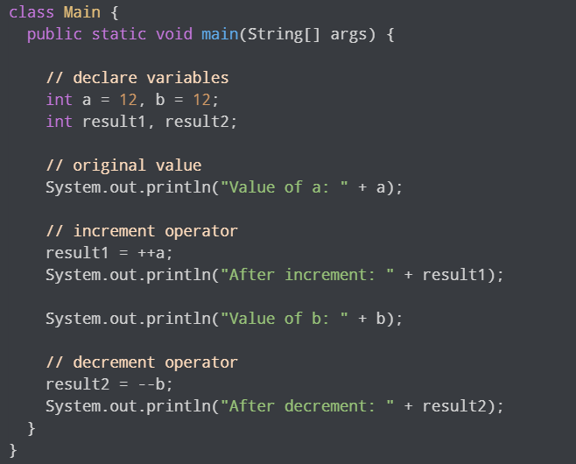
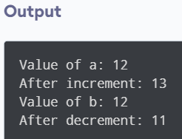
Increment and Decrement Operators Example
In the above program, we have used the ++ and -- operator as prefixes (++a, --b). We can also use these operators as postfix (a++, b++).
There is a slight difference when these operators are used as prefix versus when they are used as a postfix.

Slide 16
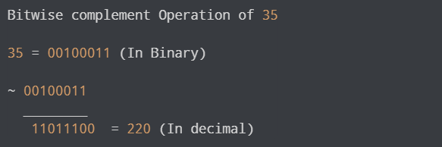
Bitwise Operators
Bitwise operators in Java are used to perform operations on individual bits.
For example,
Here, ~ is a bitwise operator.
It inverts the value of each bit (0 to 1 and 1 to 0).

Slide 17
Various Bitwise Operators
Operator | Description
~ | Bitwise Complement
<< | Left Shift
>> | Right Shift
>>> | Unsigned Right Shift
& | Bitwise AND
^ | Bitwise Exclusdive OR

Slide 18
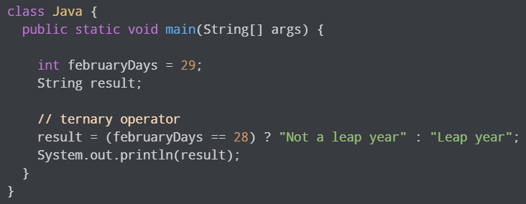
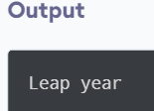
Ternary Operator
The ternary operator (conditional operator) is shorthand for the if-then-else statement.
For example,
variable = Expression ? expression1 : expression2
Here's how it works.
If the Expression is true, expression1 is assigned to the variable.
If the Expression is false, expression2 is assigned to the variable.
Let's see an example of a ternary operator.

Slide 19
Thank you

